Slide 1
The Normal Distribution, Part 2
Nina Gunnes
November 25, 2021

Slide 2
Central limit theorem
Very important theorem in statistics
Sum of many random variables approximately normally distributed
All original variables independent of each other
None of the original variables with dominant influence on the sum
Original variables not necessarily normally distributed themselves
Sample mean normally distributed due to the central limit theorem
Sample of i.i.d. variables with mean $μ$ and standard deviation $σ$
$\overline{X}=\frac{1}{n}\sum_{i=1}^{n}{X_{i}\sim \text{N}\left(μ,\frac{σ}{\sqrt{n}}\right)}$

Slide 3
Central limit theorem, cont.
Height approximately normally distributed
Influenced by genetics and factors related to prenatal life and childhood
Sum of many (more or less) independent factors
Applying to only one sex and one ethnicity at a time (why?)
https://pixabay.com/illustrations/man-icon-characters-toilet-male-1332780/
https://pixabay.com/illustrations/woman-icon-characters-toilet-1332779/

Slide 4
Normal approximation to binomial
Binomial distribution playing a central role in many settings
$P\left(X=x\right)=\left({n \atop x}\right)p^{x}{\left(1−p\right)}^{n−x}$, where $x=0,1,…,n$ and $\left({n \atop x}\right)=\frac{n!}{x!\left(n−x\right)!}$
Binomial probabilities sometimes hard to calculate
$P\left(X≥x\right)=P\left(X=x\right)+P\left(X=x+1\right)+…+P\left(X=n\right)=\sum_{k=x}^{n}{P\left(X=k\right)}$
Binomial distribution approaching normal distribution when $n$ is large
Mean (i.e., expectation or expected value): $\text{E}\left(X\right)=μ=np$
Standard deviation: $\text{SD}\left(X\right)=σ=\sqrt{np\left(1−p\right)}$

Slide 5
Normal approximation to binomial, cont.

Slide 6
Normal approximation to binomial, cont.
Approximation improving as the number of trials increases
Expected number of successes: $np≥5$
Expected number of failures: $n\left(1−p\right)≥5$
Probability calculations simplified substantially
Normal distribution easier to use than binomial distribution
Result following from the central limit theorem
Binomial variable $X$ regarded as a sum of independent indicator variables
The larger $n$ (number of trials), the more terms in the sum

Slide 7
Example (Aalen et al., 2006)
Binomial experiment of $n=20$ childbirths
Probability of a boy for each birth: $p=0.514$
$X$: number of boys; $X\sim \text{Bin}\left(n,p\right)$
Probability of more than 14 boys?
$P\left(X>14\right)=P\left(X=15\right)+P\left(X=16\right)+…+P\left(X=20\right)$
Reasonably large $n$ to use the normal distribution instead?
Expected number of boys (“successes”): $np=20×0.514=10.28≥5$
Expected number of girls (“failures”): $n\left(1−p\right)=20×0.486=9.72≥5$

Slide 8
Example (Aalen et al., 2006), cont.
Normal approximation to binomial distribution: $X\sim \text{N}\left(μ,σ\right)$
Mean: $μ=np=20×0.514=10.28$
Standard deviation: $σ=\sqrt{np\left(1−p\right)}=\sqrt{20×0.514×0.486}=2.24$
Standardization of $X$: $Y={\left(X−μ\right)}/σ={\left(X−10.28\right)}/{2.24}$
$Y\sim \text{N}\left(0,1\right)$
Using the normal distribution for the probability calculation
$P\left(X>14\right)=1−P\left(X≤14\right)≈1−P\left(Y≤\frac{14−10.28}{2.24}\right)=1−P\left(Y≤1.66\right)=1−0.9515=0.0485=4.9\%$

Slide 9
Continuity correction
Improving the normal approximation of the binomial distribution
Especially important when $n$ is small
Every value $x$ of the binomial distribution corresponding to a bar
Height of bar equal to $P\left(X=x\right)$
Bar centered at $x$, with horizontal bounds ranging from $x−0.5$ to $x+0.5$
Including the entire bar of $x$ – not just the lower (or upper) half
Approximation of a discrete distribution by a continuous distribution
$P\left(X≤x+0.5\right)$ (or $P\left(X≥x−0.5\right)$) instead of $P\left(X≤x\right)$ (or $P\left(X≥x\right)$)

Slide 10
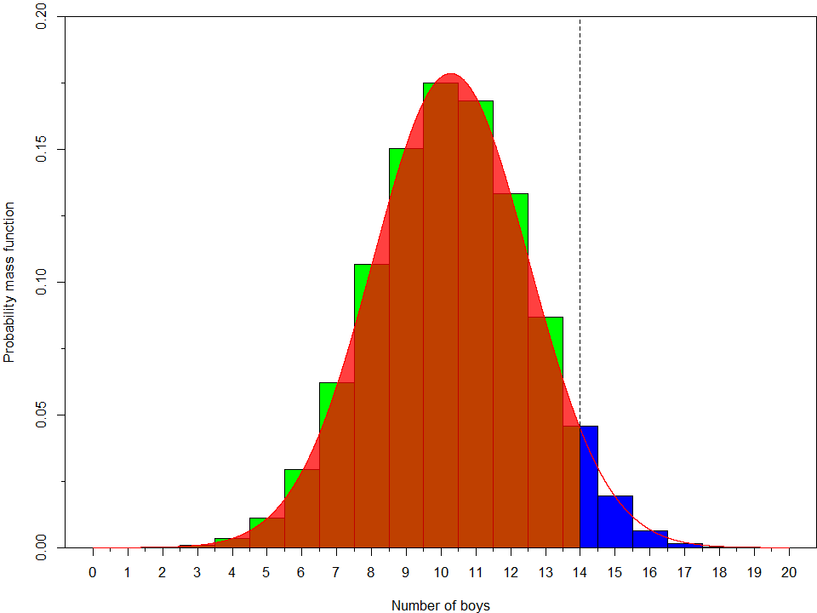
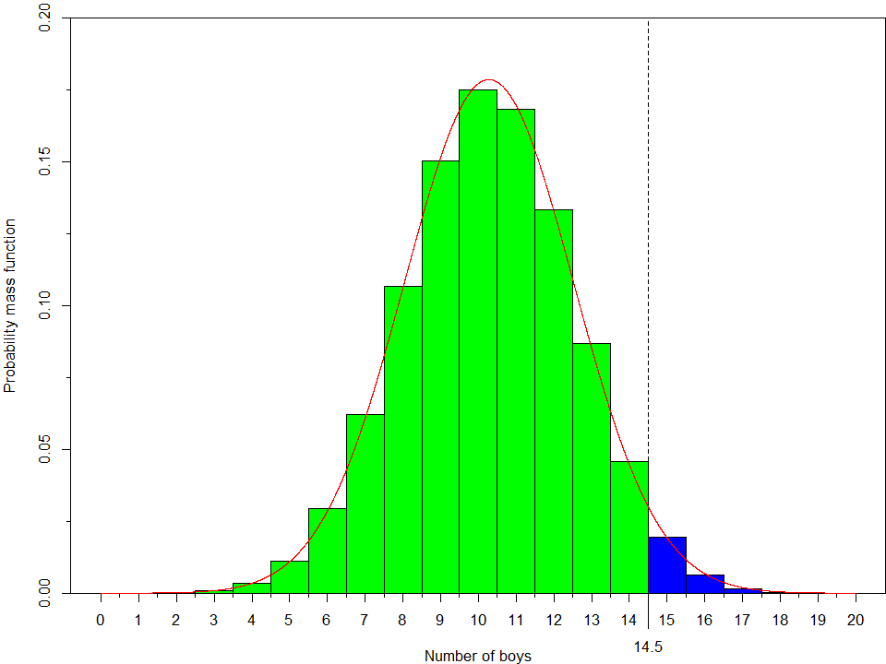
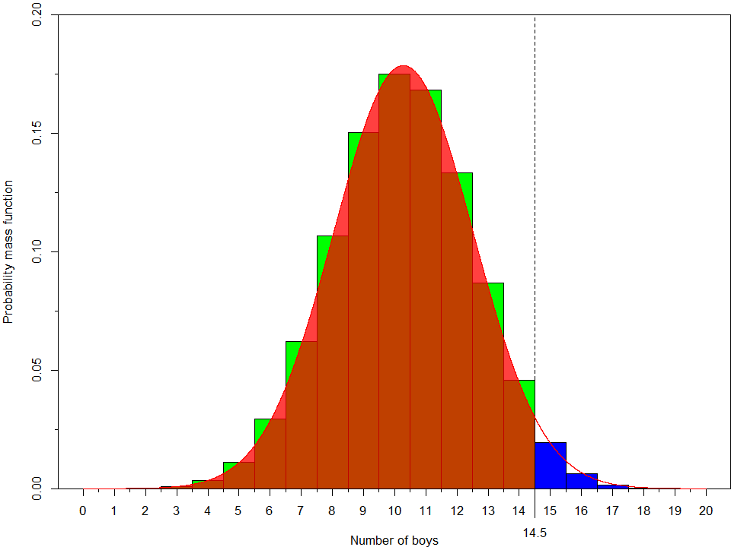
Continuity correction, cont.

Slide 11
Continuity correction, cont.
Calculating the probability of more than 14 boys of 20 childbirths
$P\left(X>14\right)≈1−P\left(Y≤\frac{14.5−10.28}{2.24}\right)=1−P\left(Y≤1.88\right)=1−0.9699=0.0301=3.0\%$
Correct binomial probability: $P\left(X>14\right)=2.8\%$
Result with continuity correction closer to the correct result than without

Slide 12
Example (Aalen et al., 2006)
Binomial experiment of $n=60000$ annual childbirths in Norway
Probability of a boy for each birth: $p=0.514$
$X$: number of boys
$X$ binomially distributed: $X\sim \text{Bin}\left(n,p\right)$
Normal approximation to binomial
$μ=\text{E}\left(X\right)=np=60000×0.514=30840$
$σ=\text{SD}\left(X\right)=\sqrt{np\left(1−p\right)}=\sqrt{60000×0.514×0.486}=122$
$X\sim \text{N}\left(μ,σ\right)⟹Y={\left(X−μ\right)}/σ={\left(X−30840\right)}/{122}\sim \text{N}\left(0,1\right)$

Slide 13
Example (Aalen et al., 2006), cont.
Probability of at least as many girls as boys?
Binomial probability very complicated to calculate
Clear advantage of using the normal approximation
$P\left(X≤30000\right)≈P\left(Y≤\frac{30000−30840}{122}\right)=P\left(Y≤−6.89\right)<0.0001$
No need for continuity correction due to large $n$
Highly unlikely that more girls than boys are born in Norway per year
Expected excess of boys: $np−\left(n−np\right)=30840−29160=1680$

Slide 14
References
Aalen OO, Frigessi A, Moger TA, Scheel I, Skovlund E, Veierød MB. 2006. Statistiske metoder i medisin og helsefag. Oslo: Gyldendal akademisk.

